Slide 1
Analyzing Hotel Booking Dynamics
Presented by : Nidhi Desai
Guide by : Mr.Abhishek Wavhal

Slide 2
Summary
Deciphering Hotel Insights : From Market Segmentation to Booking Trends
This presentation delves into a comprehensive analysis of hotel data, unravelling insights that span market preferences, cancellation trends, occupancy dynamics, and guest demographics.

Slide 3
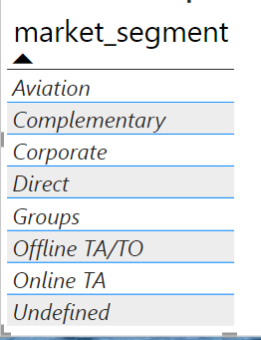
Market Segment Preferences
Which type of market segment prefer?
Use only table chart for better result

Slide 4
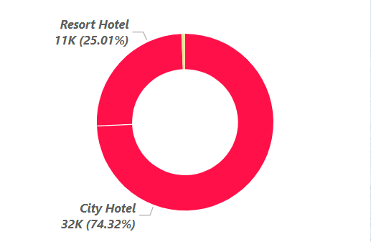
Cancellation Analysis
How many people cancelled their reservation?
Distribute between hotel

Slide 5
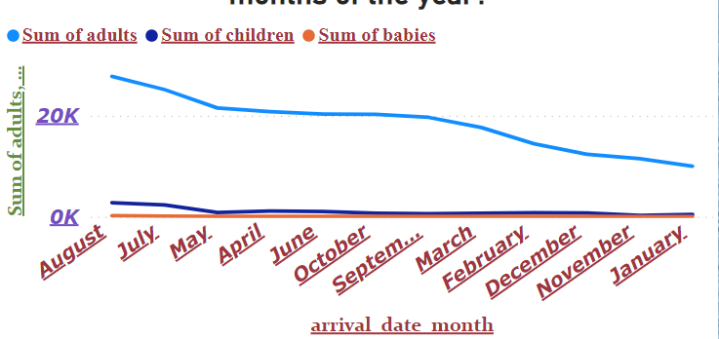
Occupancy Trends Over Months
How does the hotel occupancy vary over different months of the year?

Slide 6
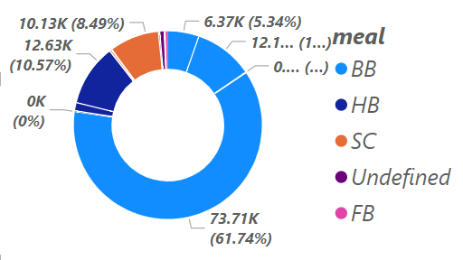
Proportion of Bookings by Market Segment
pie chart to represent the proportion of bookings from each market segment?

Slide 7
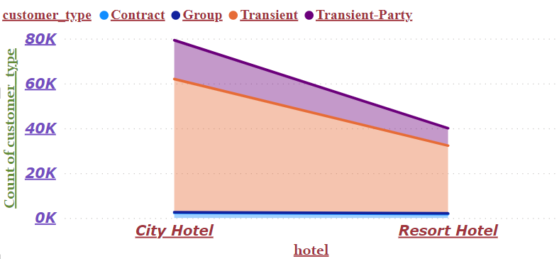
Revenue Contribution by Customer Types
Utilize a stacked area chart or a clustered column chart to showcase the revenue contribution of various customer types in each hotel?
With use of Area chart

Slide 8
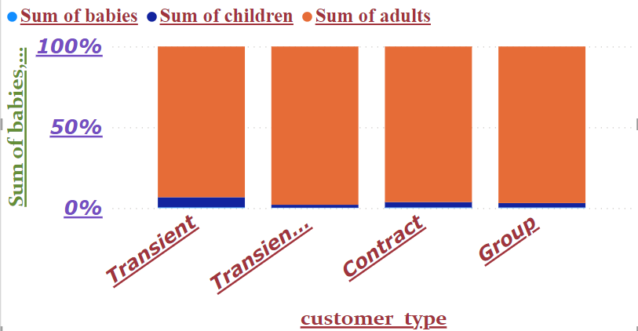
Guest Demographics Variation Across Customer Types
What is the distribution of guests based on the number of adults, children, and babies, and how does it vary across customer types?

Slide 9
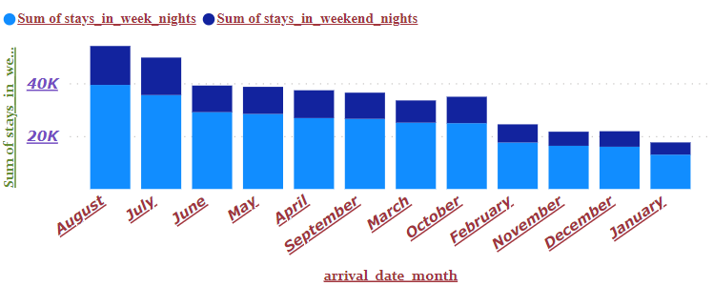
Booking Trends Over Months and Stays Distribution
How do booking trends change over different months, and what is the distribution of stays in terms of weekends and weekdays?
With use of collum chart for
better understanding

Slide 10
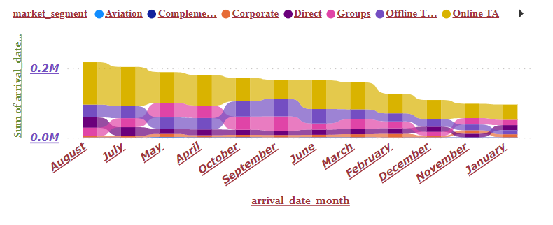
Booking Trends Over Time and Market Segment Contribution
How do booking trends vary over time, and what is the contribution of different market segments to these trends?
Showing with Ribbon Chart

Slide 11
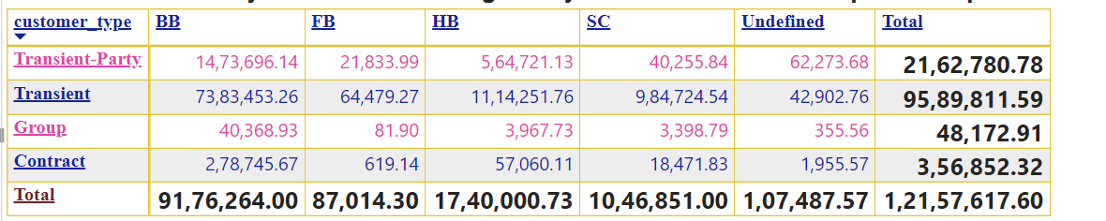
Booking Summary by Customer Types and Meal Options
What is the booking summary based on different customer types and meal options, and how does it vary in terms of average daily rate (ADR) and total special requests?

Slide 12
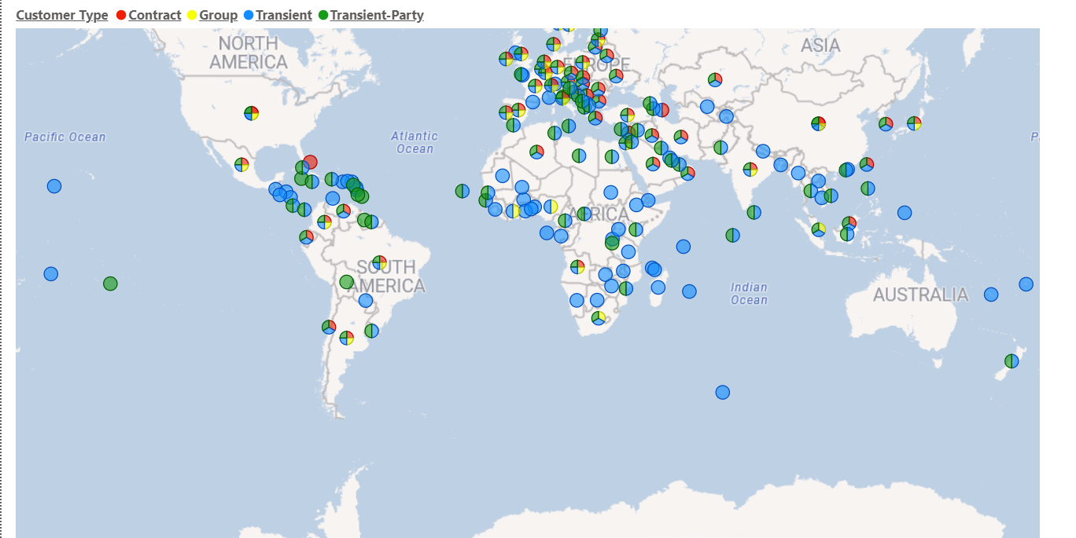
country &customer type
Filled map visualization Country & customer type

Slide 13
Conclusion :
In conclusion, a thorough analysis of these questions offers valuable insights for strategic decision-making, allowing the hotel to tailor its services, marketing efforts, and operational strategies to better meet guest preferences and optimize revenue.

Slide 14
Thank You

